Slide 1
Employee Data Analysis using Excel
STUDENT NAME:LEELAVATHI S
REGISTER NO:122200085
DEPARTMENT:B.COM (CS)
COLLEGE :PACHAIYAPP'S COLLEGE FOR WOMEN

Slide 2
PROJECT TITLE
USING PIVOT TABLES FOR EMPLOYEE TURNOVER ANALYSIS

Slide 3


AGENDA
Problem Statement
Project Overview
End Users
Our Solution and Proposition
Dataset Description
Modelling Approach
Results and Discussion
Conclusion
3/21/2024 Annual Review

Slide 4

PROBLEM STATEMENT
*Problem Statement:*
"As an HR Analyst, I need to analyze employee turnover data to identify trends, patterns, and insights that can inform strategies to reduce turnover and improve retention. However, the data is scattered across multiple spreadsheets, and manual analysis is time-consuming and prone to errors. I want to use pivot tables to streamline the analysis process, but I'm not sure how to effectively utilize them to:
- Identify top reasons for turnover

Slide 5

PROJECT OVERVIEW
Here is a potential project overview for using pivot tables for employee turnover analysis:
*Project Title:* Employee Turnover Analysis using Pivot Tables
*Objective:*
- Create a dynamic and interactive dashboard to analyze employee turnover data
- Identify trends, patterns, and insights to inform strategies to reduce turnover and improve retention
- Utilize pivot tables to streamline the analysis process and enable data-driven decision-making
.
Here is a potential project overview for using pivot tables for employee turnover analysis:
*Project Title:* Employee Turnover Analysis using Pivot Tables
*Objective:*
- Create a dynamic and interactive dashboard to analyze employee turnover data
- Identify trends, patterns, and insights to inform strategies to reduce turnover and improve retention
- Utilize pivot tables to streamline the analysis process and enable data-driven decision-making

Slide 6

WHO ARE THE END USERS?
Here are some potential end users for using pivot tables for employee turnover analysis:
1. *HR Analysts*: Responsible for analyzing and interpreting HR data, including employee turnover.
2. *HR Managers*: Oversee HR functions, including talent management, and use data insights to inform strategies.
3. *Talent Management Specialists*: Focus on employee engagement, retention, and development, and use turnover analysis to identify areas for improvement.

Slide 7
Solution: Pivot Table for Employee Turnover Analysis
Value Proposition:
- Gain actionable insights into employee turnover trends and patterns

Slide 8

OUR SOLUTION AND ITS VALUE PROPOSITION
Solution: Pivot Table for Employee Turnover Analysis
Value Proposition:
- Gain actionable insights into employee turnover trends and patterns

Slide 9
Dataset Description
*Dataset Name:* Employee Turnover Data
*Description:* This dataset contains employee-level data for analysis of turnover trends and patterns.
*Fields:*
1. *Employee ID* (Unique identifier)
2. *Name*
3. *Department*
4. *Location*

Slide 10

THE "WOW" IN OUR SOLUTION
With pivot tables, you can easily:
- Track turnover rates by department, manager, or location
- Identify trends and patterns in employee departures
- Analyze the impact of turnover on company performance
- Create custom views and reports to share with stakeholders
Some potential "wow" moments when using pivot tables for turnover analysis include:
- Discovering unexpected correlations between turnover and other HR metrics
3/21/2024 Annual Review
10

Slide 11
MODELLING
Here's a possible modelling approach for using pivot tables for employee turnover analysis:
*Step 1: Data Preparation*
- Import the dataset into Excel
- Ensure data is clean and formatted consistently
- Create a table with the following fields:
- Employee ID
- Department
- Location
- Job Title
- Tenure
- Salary
- Performance Rating
- Reason for Turnover
-
11

Slide 12
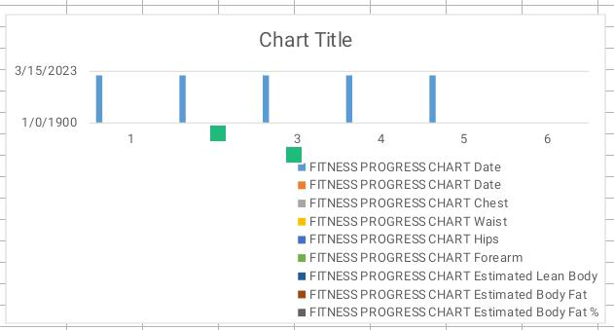
RESULTS
12

Slide 13
conclusion
Here's a potential conclusion for using pivot tables for employee turnover analysis: "By utilizing pivot tables in our employee turnover analysis, we have gained valuable insights into the trends and patterns of turnover within our organization. Pivot tables have enabled us to easily summarize and analyze large datasets, identify key drivers of turnover, and visualize the results in a clear and actionable way. Specifically, our analysis has revealed [insert key findings, such as high turnover rates in certain departments or demographics]. Armed with these insights, we can now develop targeted strategies to address these issues, improve employee retention, and ultimately drive business success.

